Slide 1

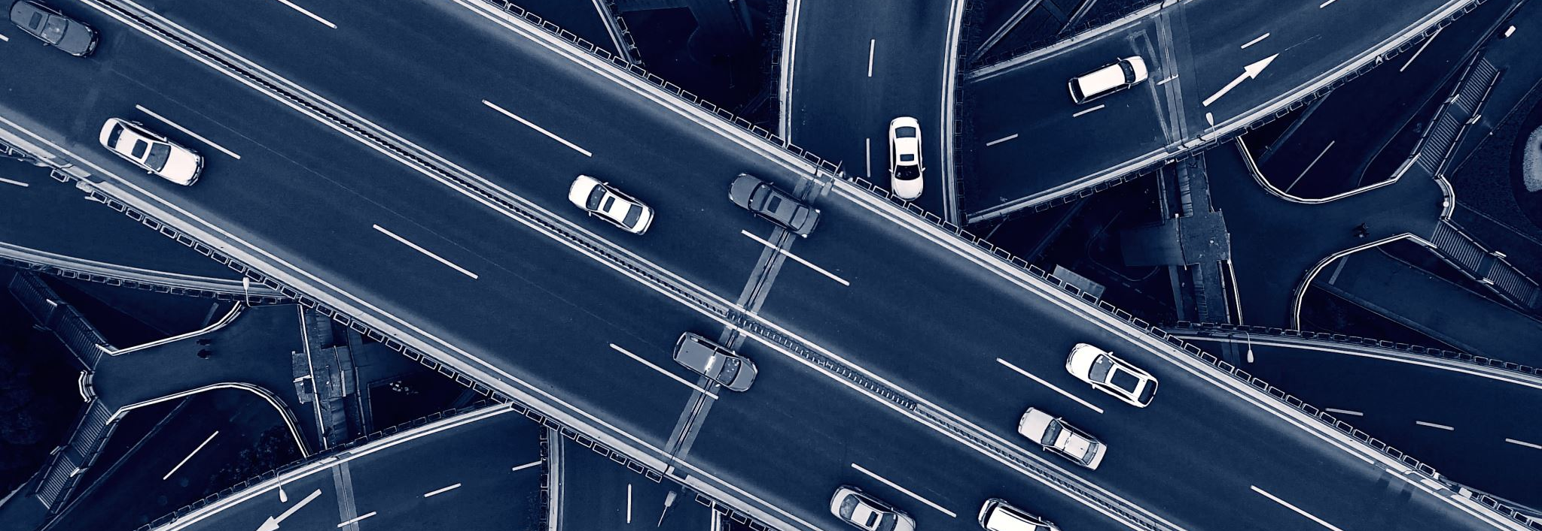


Self driving Car (S-Car)
Mohamed Otaki – G00346067
Michelle Lynch – Supervisor
Bachelor of Engineering (Honours) Software and Electronic Engineering

Slide 2
Why Self-Driving Cars
Road Safety
5,527 accidents in 2019 in Ireland
Better Environment
Reduce the fuel use and carbon emissions
Early Stages of Development
New features

Slide 3
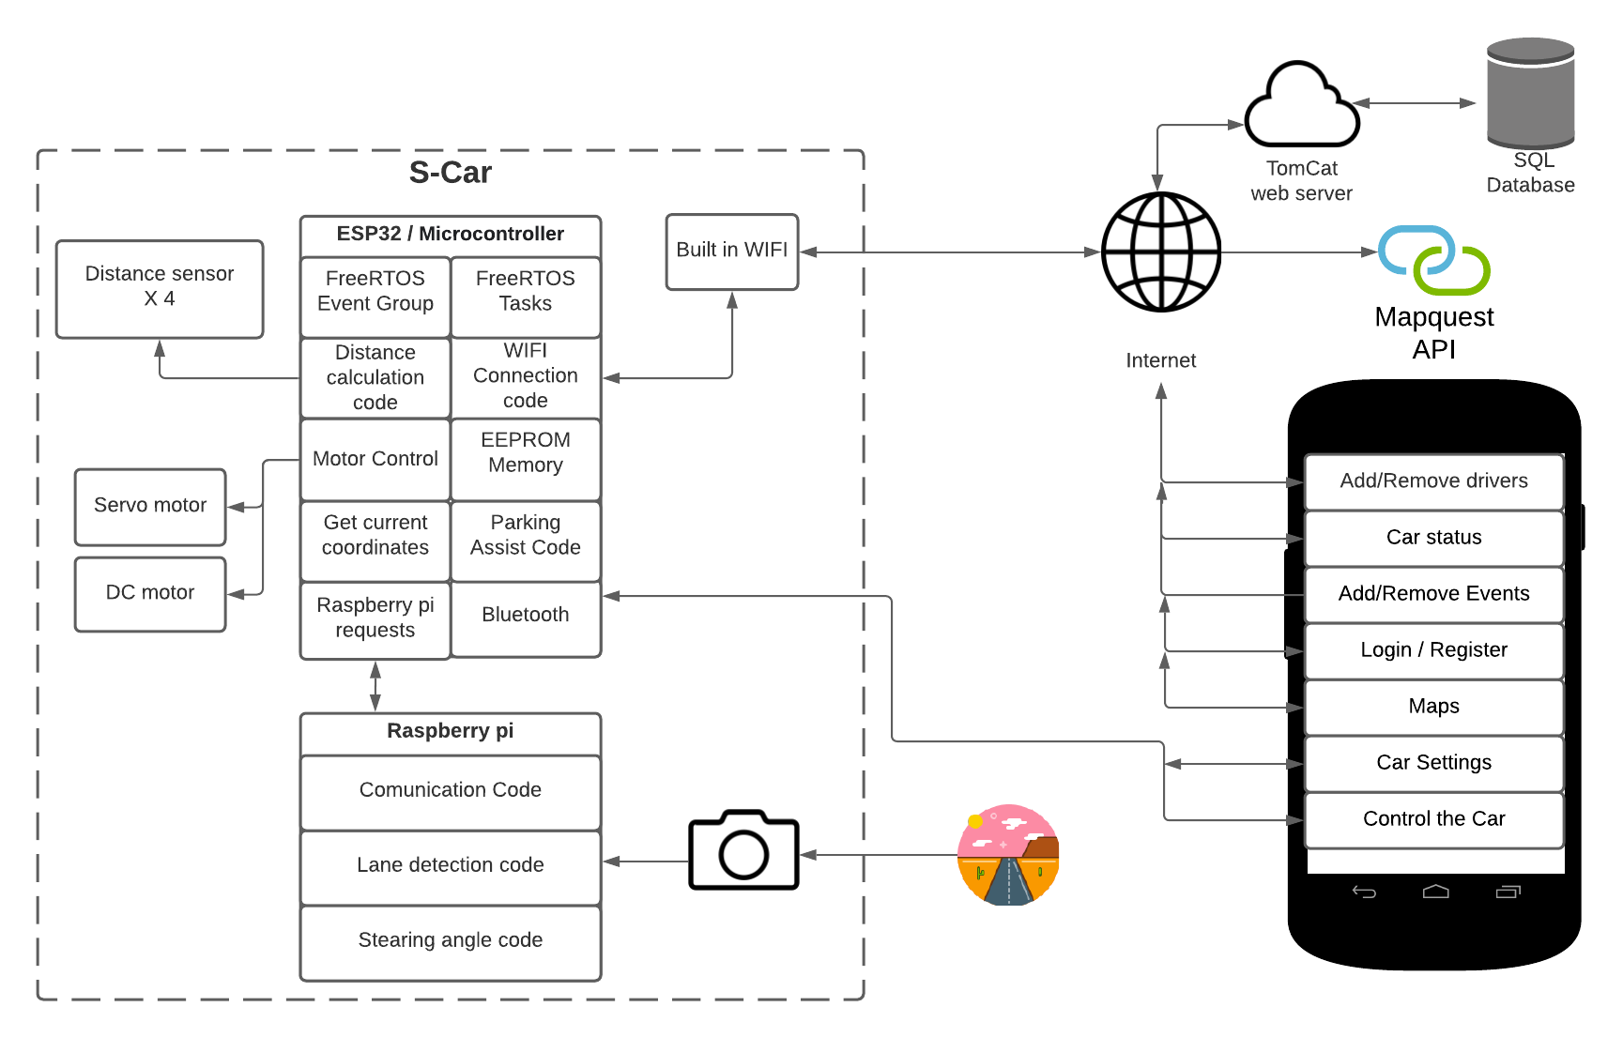
Architecture Diagram

Slide 4
S-Car Features
Parking Assist
Autonomous Driving
Android Application
Auto braking system
Calendar sync

Slide 5
Challenges
ESP32 Processing Time
FreeRTOS – Tasks
2 Cores
Ultrasonic Sensors
Free RTOS -Event group
Learn Python language

Slide 6
DEMO

Slide 7

Questions & Answers

